Slide 1
Statistic for machine learning
What is hypothesis test
Role in machine learning
P-value (probability value)
Type of tests (t-test, Chi-square test, z-test)

Slide 2
Why we need as data scientist?
Patient_ID | Blood_Pressure | Smoking_Status | Cholesterol_Level | Disease
1 | 120 | Non-Smoker | 180 | No
2 | 145 | Smoker | 240 | Yes
3 | 130 | Smoker | 220 | Yes
4 | 118 | Non-Smoker | 170 | No
5 | 160 | Smoker | 260 | Yes
Hypotheses test guiding us:
how data is collected and analyzed.
suggests a relationship between variables that can be confirmed or refuted through systematic study.
Which features are important for target column.

Slide 3
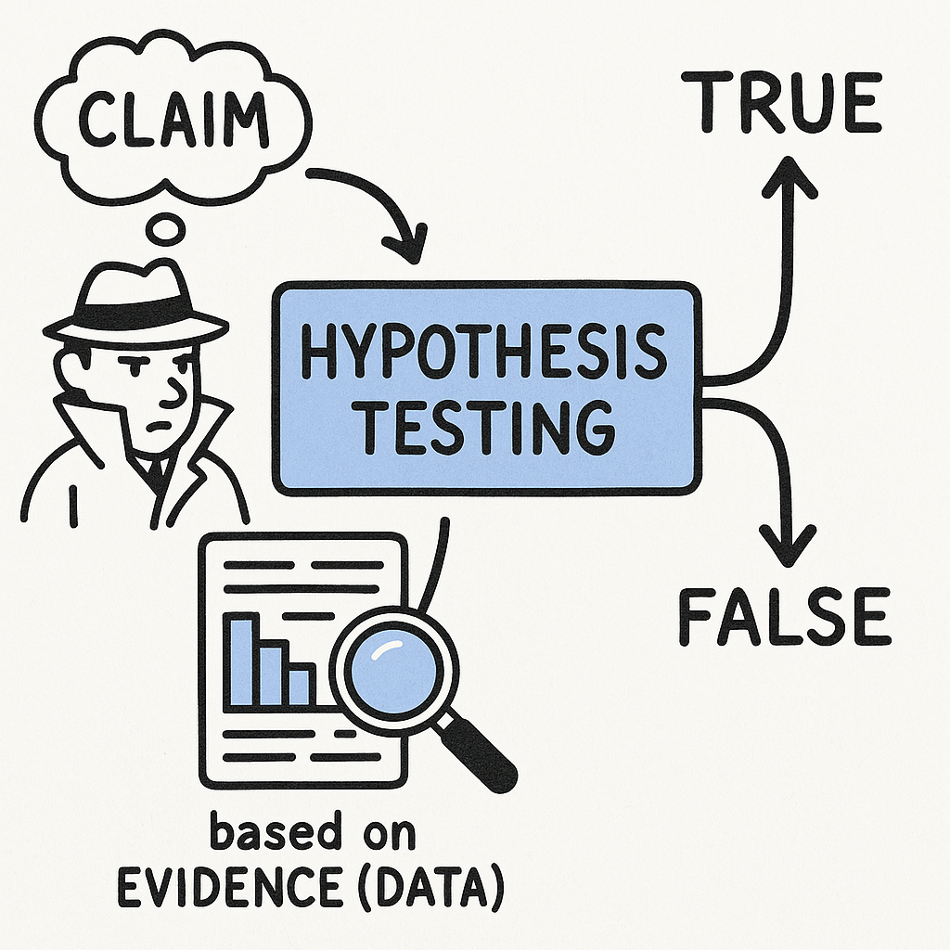
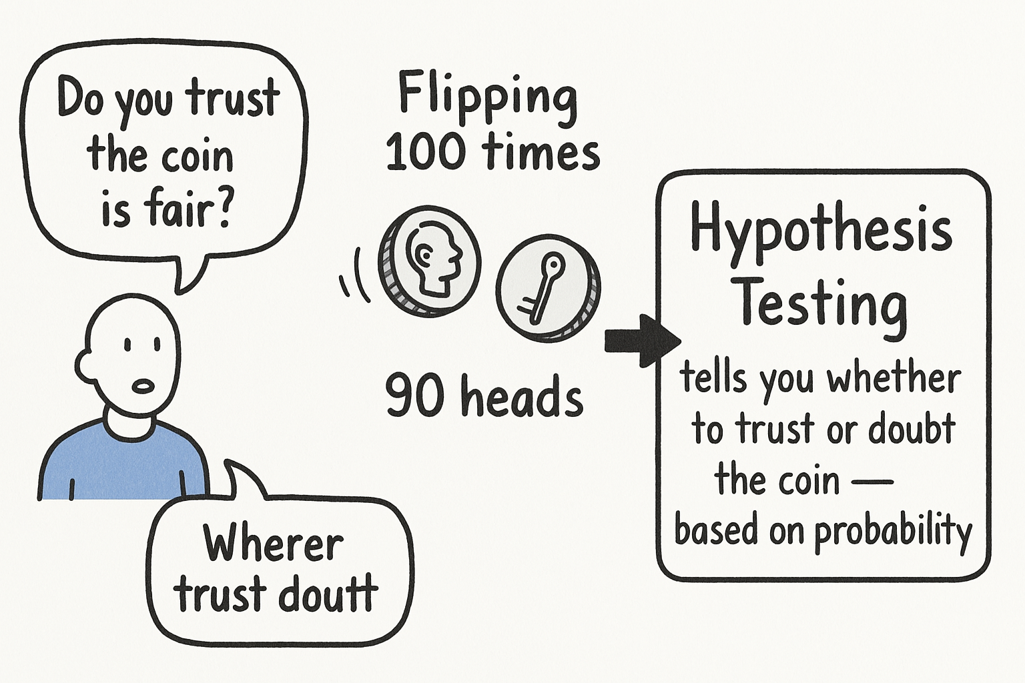
What is hypothesis test?
Imagine you are detector, trying to proof if a claim is true or false based on evidence (data). That’s what hypothesis testing does in statistic
Imagine flipping a coin 100 times and getting 90 heads. Do you trust the coin is fair? Hypothesis testing tells you whether to trust or doubt the coin — based on probability.

Slide 4
Where is Hypothesis Testing Used in a Machine Learning Project?
1. Exploratory Data Analysis (EDA) – Before Modeling
To investigate relationships or differences between variables.
Example Use:
You want to test if average income differs between two customer segments.
Use a t-test to compare means.
You want to test if a customer’s gender is related to product preference.
Use a Chi-square test for categorical association.
This helps in feature selection: keep only meaningful features.
Customer_ID | Gender | Age | Income ($) | Segment | Product_Preference
001 | Male | 34 | 45,000 | A | Electronics
002 | Female | 29 | 50,000 | B | Fashion
003 | Male | 41 | 47,000 | A | Electronics
004 | Female | 36 | 52,000 | B | Home Decor
005 | Male | 28 | 43,000 | A | Fashion
006 | Female | 33 | 51,000 | B | Fashion

Slide 5
Where is Hypothesis Testing Used in a Machine Learning Project?
2. Feature Selection / Evaluation
To test whether a particular feature significantly affects the target variable.
Example Use:
You're building a model to predict disease. You test:
Is “blood pressure” significantly different between healthy and sick patients?
Use t-test.
Is “smoking status” related to disease occurrence?
Use Chi-square test.
If the p-value is low → the feature is useful.
Patient_ID | Blood_Pressure | Smoking_Status | Cholesterol_Level | Disease
1 | 120 | Non-Smoker | 180 | No
2 | 145 | Smoker | 240 | Yes
3 | 130 | Smoker | 220 | Yes
4 | 118 | Non-Smoker | 170 | No
5 | 160 | Smoker | 260 | Yes

Slide 6
Where is Hypothesis Testing Used in a Machine Learning Project?
3. Model Comparison
To statistically compare two different models.
Example Use:
You build Model A and Model B.
You get 82% and 84% accuracy. Is the difference statistically significant, or just random?
Use a paired t-test or McNemar’s test (for classification tasks).
Model A
Model B
Sample_ID | True_Label | Model_A_Pred | Model_B_Pred
1 | 1 | 1 | 1
2 | 0 | 1 | 0
3 | 1 | 1 | 1
4 | 0 | 0 | 0
5 | 1 | 0 | 1
Run McNemar’s Test on Model A vs Model B predictions.
Compare how many predictions each got wrong/right and whether the difference is statistically significant.

Slide 7
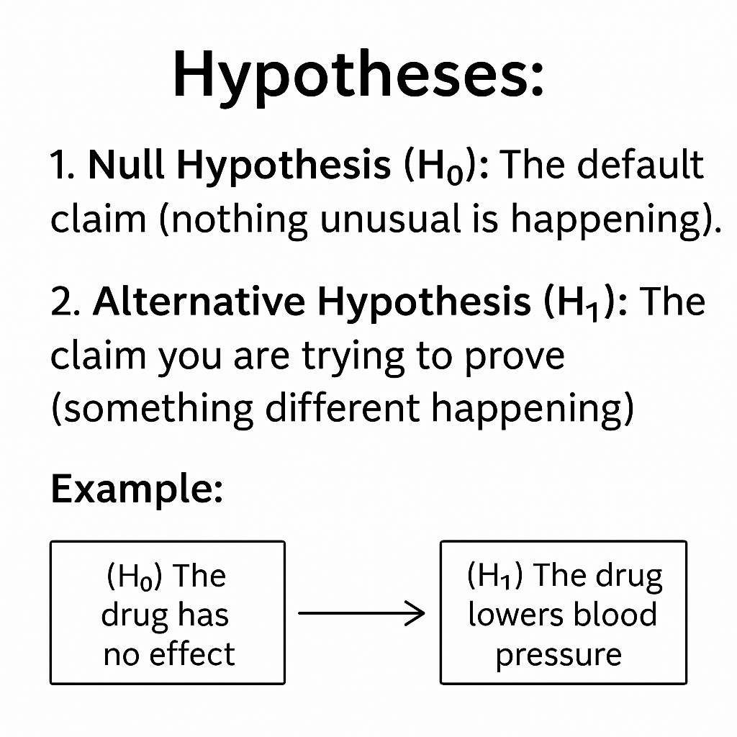
Hypotheses Key Concepts
Example: Suppose a researcher is investigating whether a new drug reduces the severity of headaches compared to a placebo. The null hypothesis (H₀) could be:
"The new drug has no effect on the severity of headaches compared to the placebo.
Example: Continuing with the drug example, the alternative hypothesis (H₁) might be:
"The new drug reduces the severity of headaches more than the placebo."

Slide 8
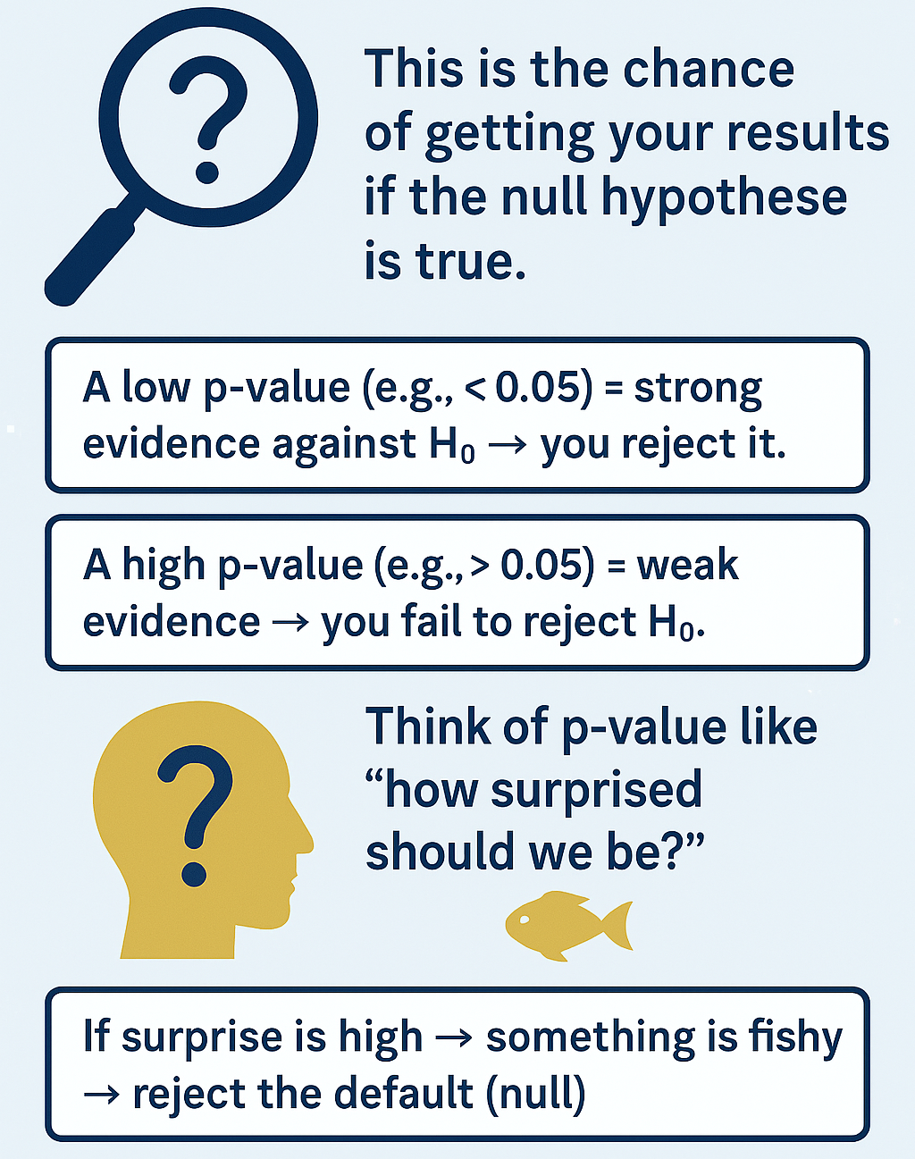
P-value (Probability value)

Slide 9

3. Types of Tests (Based on Data Type & Comparison)
t-test
Compares means (averages) between groups.
Use when you have numerical data.
Example: Compare average heights of men vs women.
Chi-square test
Compares categories/frequencies.
Use for categorical data.
Example: Do more men prefer action movies while women prefer drama?
Z-test
Like t-test but for large samples or known population std deviation.

Slide 10
Like, Share, Subscribe

